Slide 1

Used Cars

Slide 2
Team Details
Team – Fab 3
Manikonda Sarath Garikapati Sravani
Vemula RajSekharReddy

Slide 3
Objective
The objective of this project is to develop a mobile app to help users to purchase used cars from private owners in nearby cities.

Slide 4
How it Works
User can login and search for cars by applying filters like price, make, model, location, mileage, color, Seller type, etc.
Private owner can post his car details and images of the car

Slide 5
Features
Responsive UI for Mobile
USER CAN SEARCH for used CARS
Search can be performed based on location
If you are interested in a car, can find further details about that by clicking on it
CAN SEARCH FOR CARS BY APPLYING FILTERS LIKE PRICE, LOCATION, MODEL, MAKE, ETC.
SECURE AUTHENTICATION Using Passport JS & Token Creation
USER FRIENDLY UI
Private owner can post his car details and images of the car

Slide 6

Tech Stack
Mongo DB- MongoDB is a cross-platform document-oriented database program. Classified as a NoSQL database program, MongoDB uses JSON-like documents with schema
Express JS- Express.js, or simply Express, is a web application framework for Node.js. It is designed for building web applications and APIs
Angular- Angular is a TypeScript-based open-source web application framework led by the Angular Team at Google and by a community of individuals and corporations
Ionic- Ionic is a complete open-source SDK for hybrid mobile app development
Node JS- Node.js is an open-source, cross-platform, JavaScript runtime environment that executes JavaScript code outside of a web browser

Slide 7
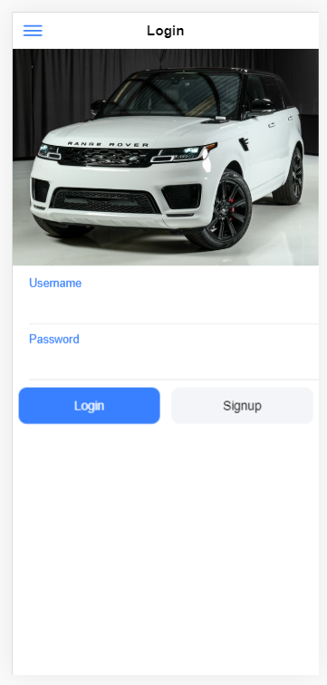
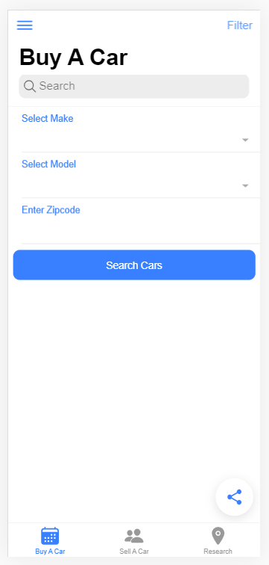
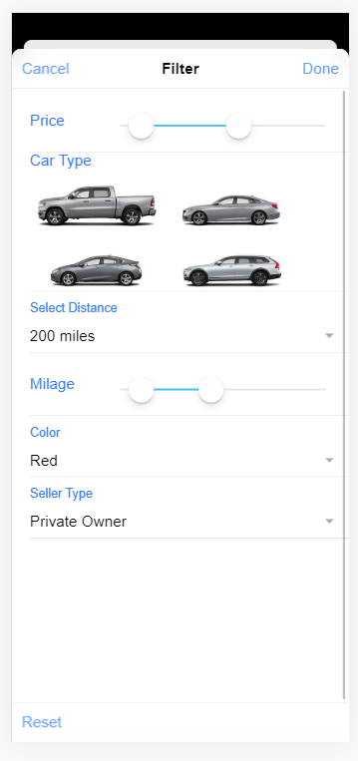
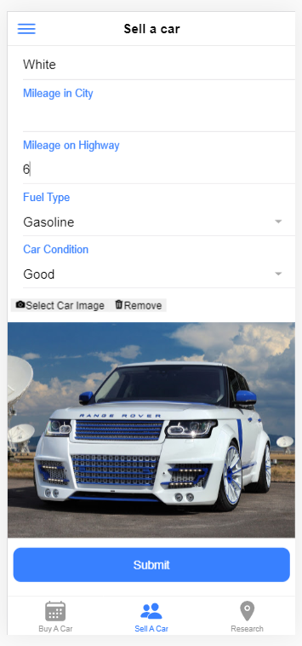
Screenshots

Slide 8
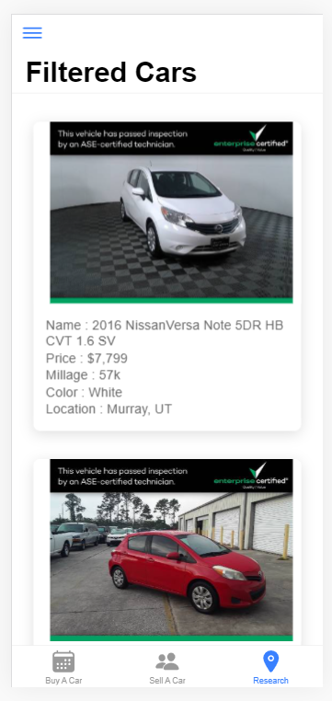
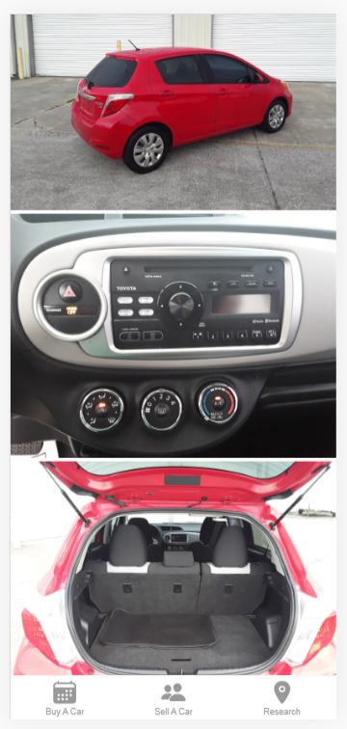
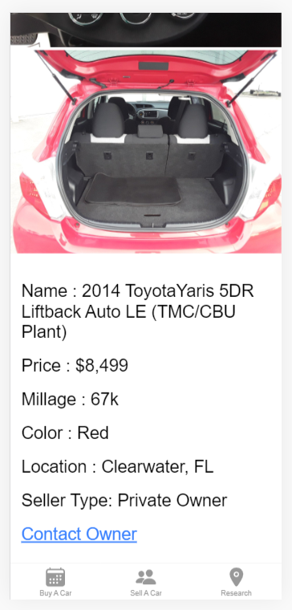
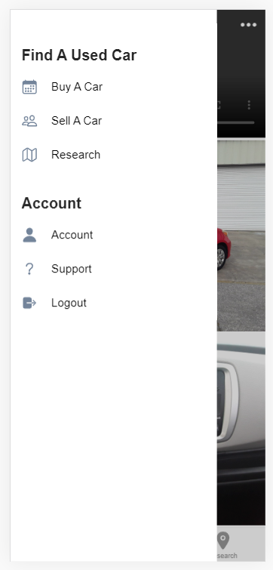
Screenshots

Slide 9

Thank You…

